Slide 1
Local Currency Settlement System (LCSS) between UAE and India
Dr Aditya Gaiha
Chief General Manager In charge FED CO RBI
adityagaiha@rbi.org.in

Slide 2
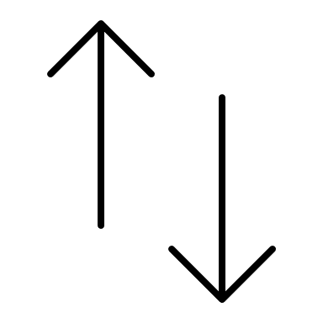
Bilateral Currency Settlement System (BCSS)
Country A – Currency A
Country B – Currency B
Exporter A
Importer B
Export / Import of goods and exchange of documents
Commercial Bank B maintains Currency B vostro account for commercial bank A and Importer B’s domestic currency account
Commercial Bank A maintains Currency A vostro account for commercial bank B and Exporter A’s domestic currency account
Debit and credit instructions for the Exporter and Importer and between their Vostro-Nostro accounts in domestic currencies Commercial banks A and B maintain a correspondent banking relationship in domestic currencies. They may exchange lines of credit in each others currencies with each other
Availing central bank swap
Availing central bank swap
Central Bank A
Central Bank swap in domestic currencies as backstop for commercial banks liquidity
Central Bank B

Slide 3
Elements of a LCSS – Local Currency Settlement System
Correspondent banking relationship
Use of local currencies - Choice of currency for invoicing and settlement - with mutual consent of importers and exporters
Use of surplus funds – freely repatriable in any currency; FDI, FPI, ECB, other current account transactions
Integration and use of national financial messaging and payment systems (SFMS, NEFT, RTGS, UPI)
Non-residents’ accounts in local currencies (SNRR, SRVA)
Permissible transactions : Trade transactions (including oil and petroleum payments) in local domestic currencies; other current account transactions and permissible capital account transactions

Slide 4
Market determined exchange rate between AED and INR - no administrative fixing of an exchange rate between authorities or central banks; commercial banks on both sides would decide the exchange rates based on the prevailing market rates.
Initially direct quotes between INR and AED would be (calculated) through a third currency like USD.
Hedging - Residents of both countries to participate in the onshore currency markets for hedging etc.
Certain changes in FEMA guidelines to enable / facilitate LCSS are on the anvil

Slide 5
Questions? Thank you!

